Slide 1

RISK AND RESILIENCE BOOTCAMP
2

Slide 2


Slide 3
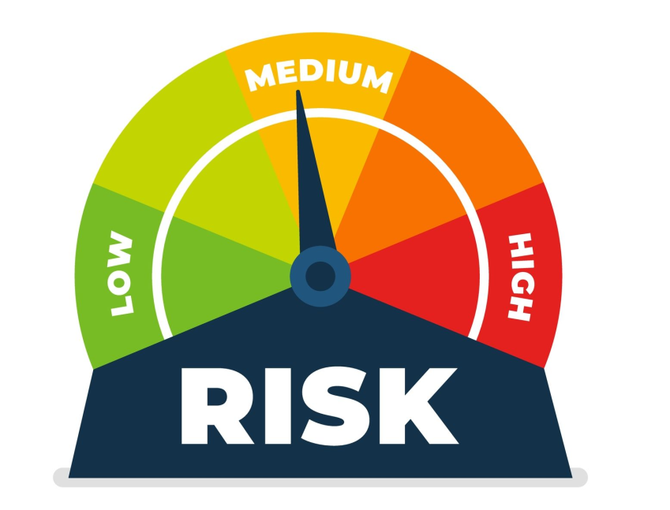
Risk typology
In this module we will explore
The taxonomy of risk categories and risk types with mapping into IT / resilience contexts
How these risks intersect with IT, cyber, and resilience (DRII) considerations
Classifying real-world risk scenarios into categories/types

Slide 4
Introduction
Not all risks are equal
We need consistent categories so we can structure governance, allocate resources, monitor, and respond to events
The ISACA Risk IT Framework, treats “IT-related risk” as one component among other enterprise risk categories
For example: strategic, operational, compliance
Resilience thinking (DRII) views risks not just by domain but by their impact on continuity and recovery
Meaning the taxonomy of risks must link to resilience design

Slide 5
Risk Categories (Enterprise-Level)
These are the “buckets” under which risks are grouped at the enterprise ERM level
The next slide is a standard categorization often used in ERM
Cross-referenced with IT examples and notes on resilience connection
Additional categories sometimes used
Financial or credit risk (especially in banks) arising from credit defaults, market swings
Market or competitive risk: if tech investments fail to yield competitive advantage
External risk: natural disasters, climate, supply chain shock
In practice, an organization may tailor or add more categories
Butt the core four on the next are widely used and map well into risk governance

Slide 6
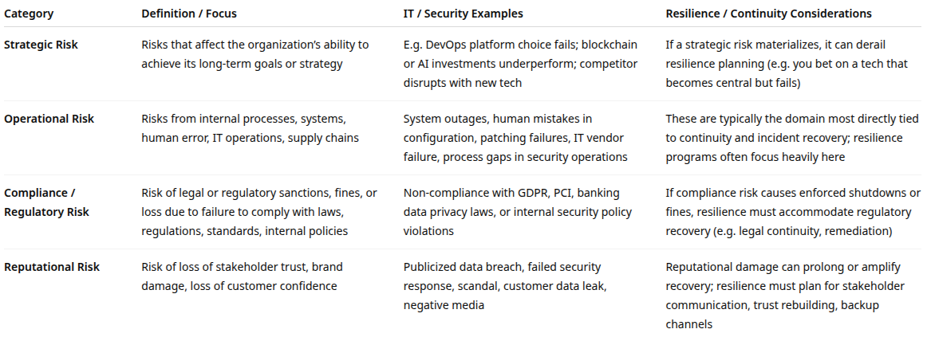
Risk Categories (Enterprise-Level)

Slide 7
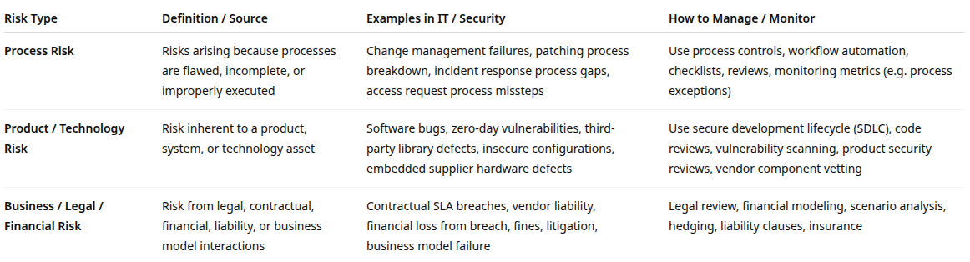
Risk types
Risk categories are broad domains
Risk types are more detailed classifications of how risk can arise
Typically by source or nature of failure or deviation

Slide 8
Risk types
Sometimes we see subtypes as a result of blending
Legal and regulatory risk: often under “Business / Legal / Financial”
Technology and infrastructure risk: overlaps “Product / Technology”
Third-party and supplier risk: can be a composite of process, product, legal
Information and data risk: cross cuts confidentiality, integrity and availability
Often treated as a separate axis because it cuts across process/product types
Risk types can be viewed as modes of failure with categories as domains of impact

Slide 9
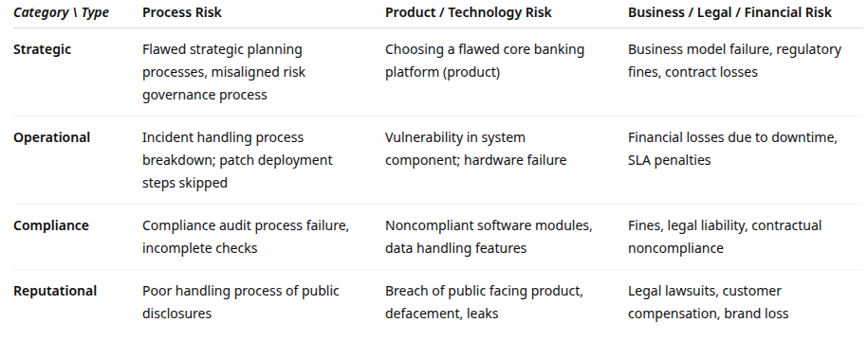
Mapping: Category × Type Matrix

Slide 10
From ISACA
Emphasizes that IT / I&T-related risks transcend categories
A risk might be operational, strategic, or compliance in nature depending on context
Each risk must be mapped into the enterprise risk taxonomy rather than being managed in isolation
Describes risk scenario construction
Evaluates asset, threat, event, vulnerability, impact
Helps classify risk type and category more precisely
Recommends aligning IT risk management with ERM
Ensures that categories and types are consistent across the enterprise

Slide 11
Resilience Perspective
DRI emphasizes resilience more than taxonomy
Glossary for Resilience defines key resilience terms
“Acceptable risk,” “impact tolerance,” “capability loss”
Links into risk classification work.
Risk categories are often mapped to critical functions and their exposures
For example: how strategic, operational, compliance, or reputational risks threaten continuity of key services
Classifying risk types helps in BIA, risk assessment, and response planning
DRII’s annual risk and resilience trends report highlights common operational and emerging risks
Serves as de facto risk categories in practice
For example: cyber events, IT disruptions, reputational issues

Slide 12
Risk types
Process risks
Arise from failures or inefficiencies in internal business or IT processes
Examples
Ineffective change management leading to deployment errors
Manual data entry processes causing transaction inaccuracies
Poorly defined incident escalation procedures delaying recovery
Impact
May cause operational disruptions, reduced service quality, or compliance violations
Mitigation and resilience practices
Implement process standardization through Standard Operating Procedures (SOPs)
Embed control checkpoints and automated validations
Regularly test recovery and continuity procedures to ensure process resilience
Use continuous improvement and root cause analysis (RCA) to strengthen weak processes

Slide 13
Risk types
Product risks
Associated with the design, development, quality, or delivery of a product or service
Includes software quality, security vulnerabilities, and service reliability
Examples:
Defective software releases impacting customer experience
Unpatched vulnerabilities in customer-facing applications
Inadequate testing during product lifecycle phases
Impact
Loss of customer trust, reputational damage, or financial penalties
For example: service downtime or noncompliance
Mitigation and resilience practices
Apply QA and DevSecOps practices throughout the product lifecycle
Perform risk-based testing (RBT) to prioritize testing of high-impact areas
Use configuration management to track and control software versions
Maintain rollback and failover mechanisms for resilience during releases

Slide 14
Risk types
Business risks
Affect the organization’s ability to achieve strategic, financial, or regulatory objectives
Often arise from the external environment
For example: market, competitors, legislation changes
Or from internal governance and decision-making weaknesses
For example: overestimating the organization’s capability or ignoring market data and analyses
For example: incompetent executives or toxic work environments

Slide 15
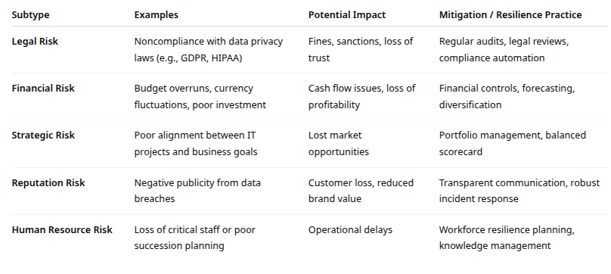
Risk types
Business risk subtypes

Slide 16
correlations
Asset
Anything of value to the organization
Financial assets
Information
Business and supporting processes
Infrastructure
People
Reputation
Risk = Threat × Vulnerability × Asset Value
This is a refinement of the terminology from before
The outcome can be thought of as the negative impact on the value of an asset
Without an asset to protect, there is no risk
Without a vulnerability, threats have no entry point
Without a control, the risk remains unmitigated

Slide 17
correlations
Correlations
Assets are protected by Controls
Assets are exposed via Vulnerabilities
Vulnerabilities are exploited by Threats
Exploited Vulnerabilities are Risk Events
Risk Events reduce the value of Assets

Slide 18
Example
A bank’s customer facing banking interface
Asset: Online banking platform
Question: What sort of asset is this? Can it represent more that one actual asset?
Threat: Cybercriminal attempts to use stolen credentials
Vulnerability: Weak password policy and lack of two-factor authentication
Risk: Unauthorized access to customer accounts
Control: Implement MFA, monitor failed login attempts, perform security testing

Slide 19
Integration
Integration with risk management lifecycle
Both ISACA and DRI emphasize continuous improvement
Identify assets and threats
Assess vulnerabilities and risks
Design and implement controls
Monitor effectiveness and adapt
Review after incidents for continual improvement
Continuous feedback loop strengthens operational resilience

Slide 20
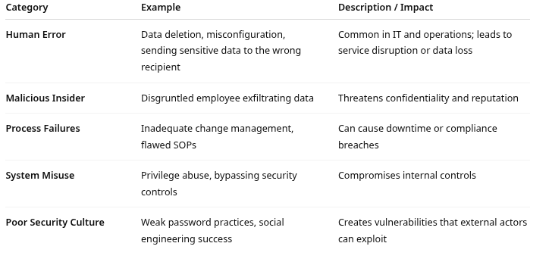
Internal vs. External Threats
Internal threats
Internal threats originate within the organization
Come from employees, contractors, systems, or processes that are part of the enterprise environment
May be intentional (malicious actions) or unintentional (accidents, negligence, process errors)

Slide 21
Internal vs. External Threats
Internal threats
Key drivers (root causes) example
Lack of security awareness training
Weak role-based access control and monitoring
Poor process documentation and change governance
Inadequate separation of duties
Mitigation and resilience strategies examples
Preventive controls
Implement least-privilege access and multi-factor authentication (MFA)
Conduct employee security training and periodic awareness refreshers
Detective controls
Monitor logs and behavior analytics for anomalous activities
Employ data loss prevention (DLP) tools
Corrective controls
Ensure backup, recovery, and version control systems are robust
Use post-incident reviews to strengthen process maturity

Slide 22
DLP Tools
Data Loss Prevention (DLP) tools
Security solutions designed to detect, monitor, and protect sensitive data to prevent unauthorized access, leakage, or exfiltration
Monitors when data is in use, in motion, or at rest
Core functions
Data discovery and classification
Scans systems, databases, and endpoints to identify sensitive or regulated data
For example: personal, financial, or proprietary information
Applies classification tags for monitoring and enforcement
Correlates with DAMA best practices

Slide 23
DLP Tools
Core functions
Policy enforcement
Defines rules that restrict how sensitive data can be accessed, transferred, or shared
For example, blocking external email attachments containing credit card numbers
Monitoring and detection
Tracks data movements across endpoints, networks, and cloud environments to detect policy violations or unusual activity
Incident response and reporting
Alerts administrators, quarantines data, or blocks transmission when a potential data loss event occurs
Generates reports for compliance audits and investigations

Slide 24
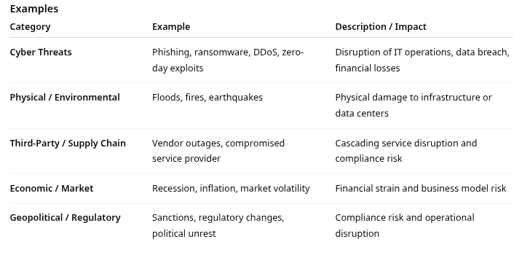
Internal vs. External Threats
External threats
External threats originate outside the organization’s boundaries
Driven by actors or forces not under the organization’s control
For example: cybercriminals, competitors, environmental factors, and geopolitical events
Often exploit vulnerabilities introduced by technology exposure, supply chain dependencies, or public-facing systems

Slide 25
Internal vs. External Threats
External threats
Key driver (root causes) examples
Increased exposure from digital transformation and cloud services
Globalized supply chains with interdependencies
Rapidly evolving threat landscape (e.g., AI-driven attacks)
Natural and geopolitical instability

Slide 26
Internal vs. External Threats
Preventive control examples
Perform vendor risk assessments and due diligence
Implement perimeter defences, intrusion detection, and patch management
Design geographically diverse continuity and recovery sites
Detective controls
Continuous monitoring of external threat intelligence feeds
Establish Security Operations Centers (SOC) or Managed Detection and Response (MDR) partnerships
Corrective controls:
Test disaster recovery and continuity plans regularly.
Include supply chain resilience in risk assessments and contracts.

Slide 27
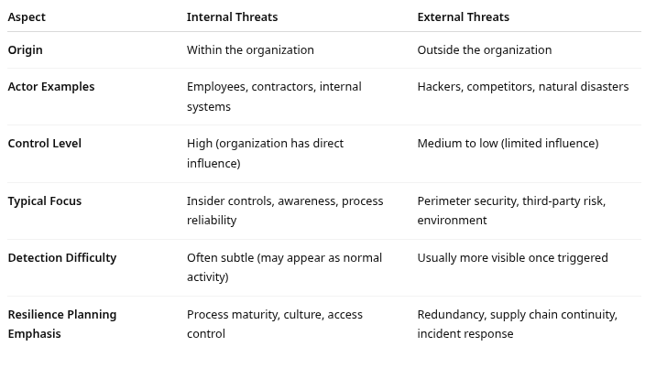
Internal vs. External Threats

Slide 28

Q&A and open discussion
Notes:
Now is the time to engage in an interactive Q&A session where you can ask questions, share insights, and clarify any doubts about the topics we have covered so far.
This open discussion is designed to ensure that every participant has the opportunity to voice their thoughts and learn from the collective experience of the group.
Your questions and comments are valuable as they help us identify areas that may need further explanation and enable us to tailor future sessions to your needs.
We encourage you to speak up and contribute to the dialogue, as this interaction is one of the key components of our interactive learning approach.
As the session progresses, take note of any questions or ideas that you would like to revisit, and feel free to share your perspectives with the class.

